Slide 1
Creating Accessible Content

Slide 2
Visible & Invisible
Approximately 56.7 million people are considered to have a severe disability.
Only 15 million people use a mobility device, such as a wheelchair, cane, crutches, or walkers.
41 million of the people defined as having a severe disability do not use a mobility (visible) device.
You can’t always “see” who has a disability and who does not.

Slide 3
How you can help
Email Signature
ALT Text Pictures
Color Contrast
Reading Order
Closed Captioned
Universal Design
Universal Design Instruction

Slide 4
“UDI (Universal Design Instruction) is the proactive design and use of inclusive, instructional strategies that benefit a broad range of learners including students with disabilities.”
Scott, McGuire, & Embry (2002)

Slide 5
Nine Principals of UDI
Equitable use
Flexible in use
Simple and intuitive
Perceptible information
Tolerance for errors
Low physical effort
Size and space for approach and use
A community of learners
Instructional climate

Slide 6
Technology/Software
Text reader (Claro Read/Read & Write)
Screen Reader (JAWS - Job Access Work System)
Dictation Software (Dragon)
Inspiration (Mind Mapping)
Zoom Text (Text Enlarger)
Sonocent (Audio Note Taker)
Adobe Acrobat
YouTube (Caption)
My Math (Math Jaxs)
Adobe Reader XL
Microsoft Word/Power Point
PDF

Slide 7
Microsoft Word
Text is readable [font (Arial, Calibri, Verdana) color, size (18pt-22pt) and clarity]
Text is navigable (headings, also called “Styles”)
Text is formatted clearly (spacing, columns, section breaks, and text box)
Text is meaningful (acronyms explained, clear hyperlinks)
Graphics are fully described (alternative text)
Tables are clear and simple (descriptions, heading row)
Check accessibility (file, information, and check for issues)

Slide 8
Power Point
Design and formatting
Slide titles are unique
Reading order (Important information first)
Accessible text for screen reading software
Graphics are fully described

Slide 9
Power Point Design and Format
Background – place text on a solid background not over an image
Layout – use a standard layout template with text place holders
Color contrast – between your font and background
  https://www.paciellogroup.com/resources/contrastanalyser/
  http://webaim.org/resources/contrastchecker/

Slide 10
Power Point Slide Titles
Each title should have a unique title
This helps clarify your presentation and organize your ideas
Helps your audience focus

Slide 11
Power Point Selection Reading Order
Click Home tab
In the Drawing section, Select Arrange
In the Arrange drop down, Select Panel

Slide 12
Power Point Accessible Text
Text style (Arial, Calibri, Verdana)
Size (Title 40pt, Text 22pt)
Please do not add your own text box

Slide 13
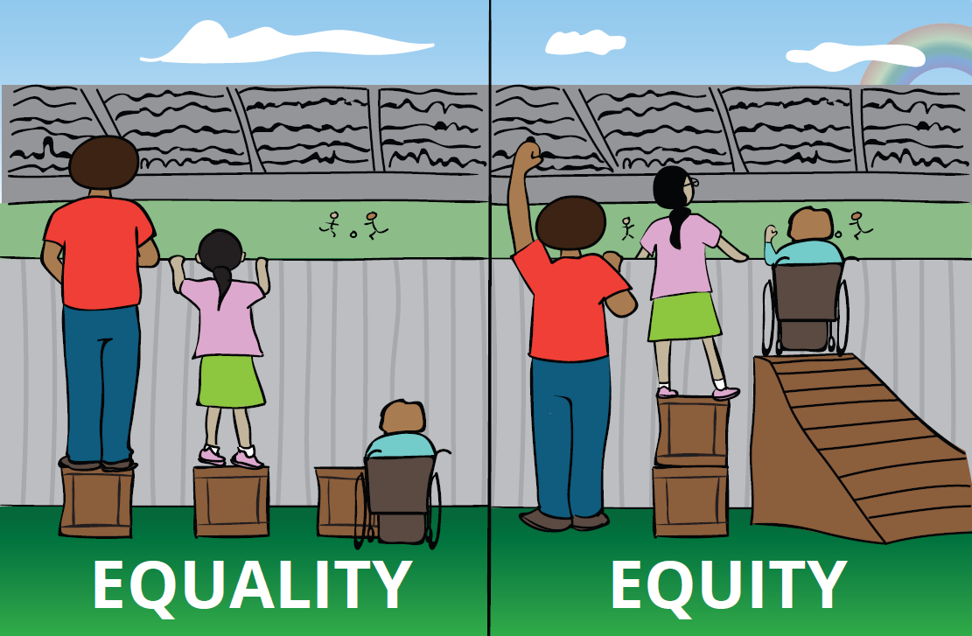
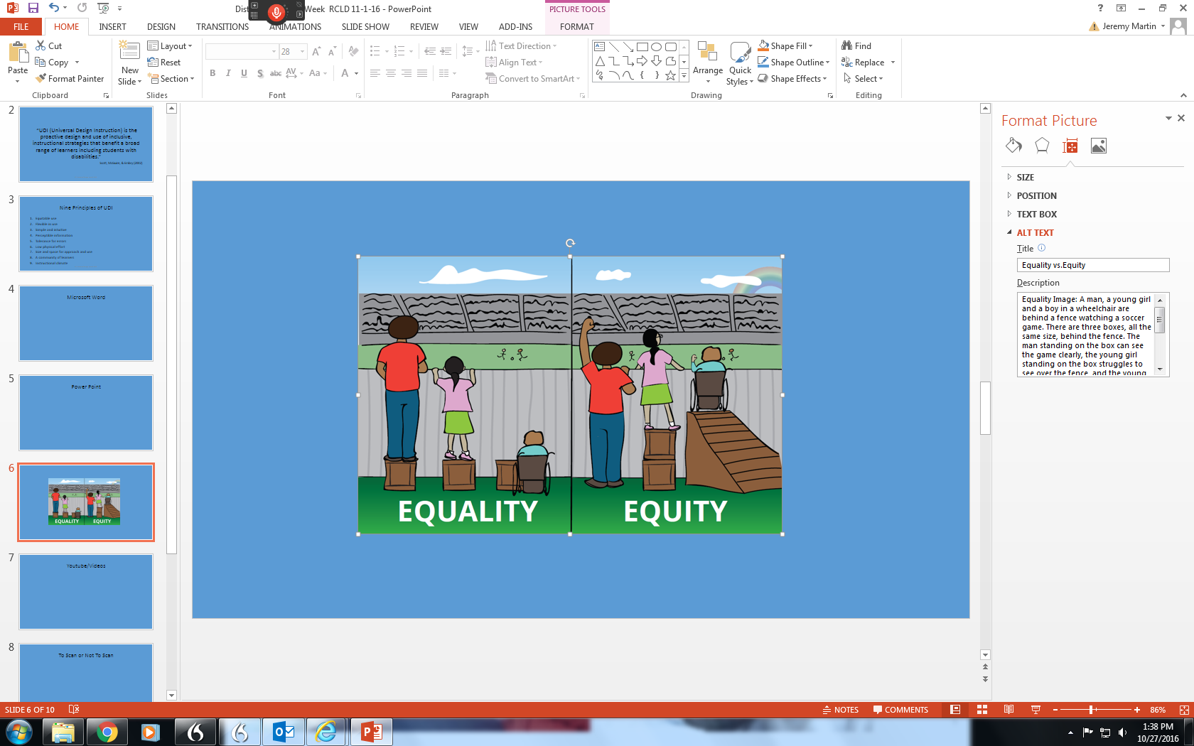
Power Point Image

Slide 14
To Scan or Not To Scan

Slide 15
PERSON FIRST LANGUAGE
Words are powerful and they can hurt! People First Language is about respect, dignity, and putting the person first, not the condition.
Mark Twain said…“The difference between the right word and the almost right word is the difference between lightening and the lightening bug.”

Slide 16
PERSON FIRST LANGUAGE
USE
Person with Down Syndrome
Congenital disability
Speech or communication delay
Person without disabilities/ typical person
AVOID
The Down’s person
Birth defect
Tongued tied
Normal/ healthy/
able-bodied

Slide 17
Accessibility Help
https://support.office.com/en-us/article/Use-the-Accessibility-Checker-on-your-Windows-desktop-to-find-accessibility-issues-a16f6de0-2f39-4a2b-8bd8-5ad801426c7f
https://support.office.com/en-us/article/Accessibility-video-training-71572a1d-5656-4e01-8fce-53e35c3caaf4?ui=en-US&rs=en-US&ad=US

Slide 18
QUESTIONS!

Slide 19
Sources
PTI Universal Design strand 2016
AMAC Presentation 2016
https://www.paciellogroup.com/resources/contrastanalyser/
http://webaim.org/resources/contrastchecker/

Slide 20
Portland Community College
Https://www.youtube.com/watch?v=eks3r-nE9lU
  Watch first 6 min

